Slide 1
Chapter 6
Programming

Slide 2
Solving Problems using a Computer
Methodologies for creating computer programs
that perform a desired function (i.e., solve the problem).
Problem Solving
  How do we figure out how to tell the computer what to do?
  Convert the problem statement into an algorithm,
  using stepwise refinement
  Convert the algorithm into LC-3 machine instructions.
Debugging
  How do we figure out why it didn’t work?
  Examining registers and memory, setting breakpoints, etc.
Time spent on the first can reduce the time spent on the second!
6-<number>

Slide 3
Stepwise Refinement
Also known as systematic decomposition.
Start with problem statement:
  “We wish to count the number of occurrences of a character
  in a file. The character in question is to be input from
  the keyboard; the result is to be displayed on the monitor.”
Decompose task into a few simpler subtasks.
Decompose each subtask into smaller subtasks,
and these into even smaller subtasks, etc....
until you get to the machine instruction level.
6-<number>

Slide 4
Problem Statement
Because problem statements are written in English,
they are sometimes ambiguous and/or incomplete.
  Where is “file” located? How big is it, or how do I know
  when I’ve reached the end?
  How should the final count be printed? A decimal number?
  If the character is a letter, should I count both
  upper-case and lower-case occurrences?
How do you resolve these issues?
  Ask the person who wants the problem solved,
  Make a decision and document it, or
  Parameterize the issue and let the user decide when he/she runs the program.
6-<number>

Slide 5
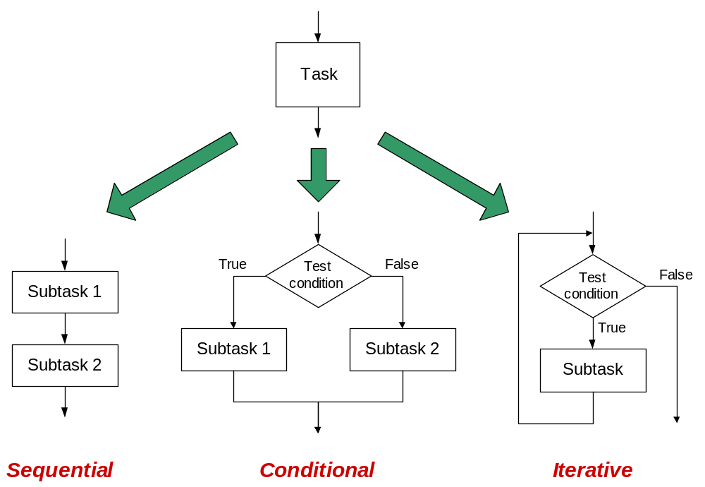
Stepwise Refinement
Copyright © The McGraw-Hill Companies, Inc. Permission required for reproduction or display.
모두 single entry, single exit – implication?
6-<number>

Slide 6
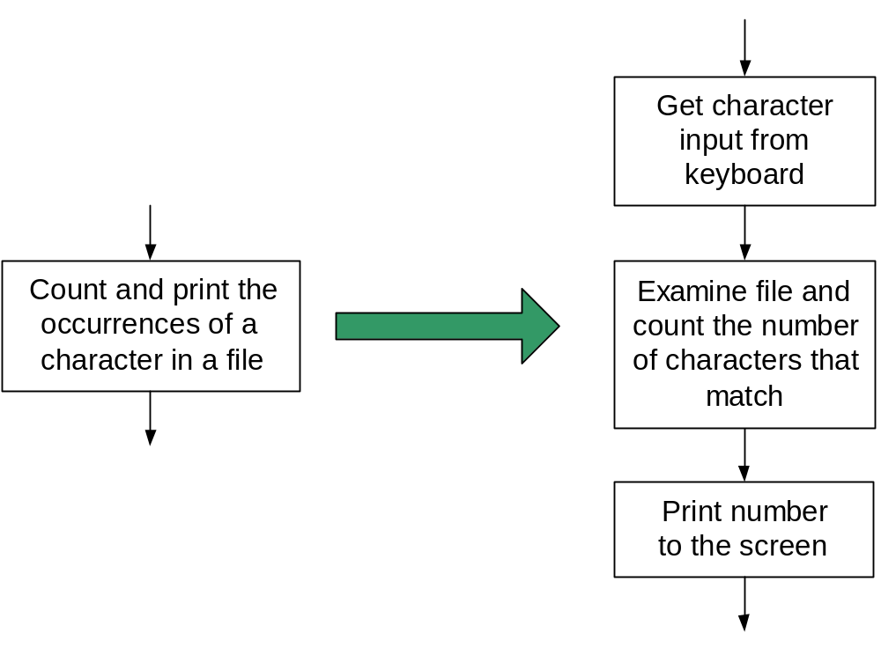
Sequential
Do Subtask 1 to completion,
then do Subtask 2 to completion, etc.
6-<number>

Slide 7
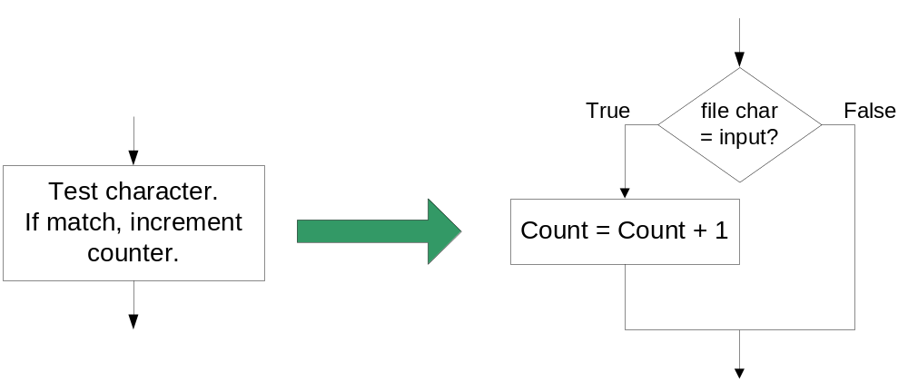
Conditional
If condition is true, do Subtask 1;
else, do Subtask 2.
6-<number>

Slide 8
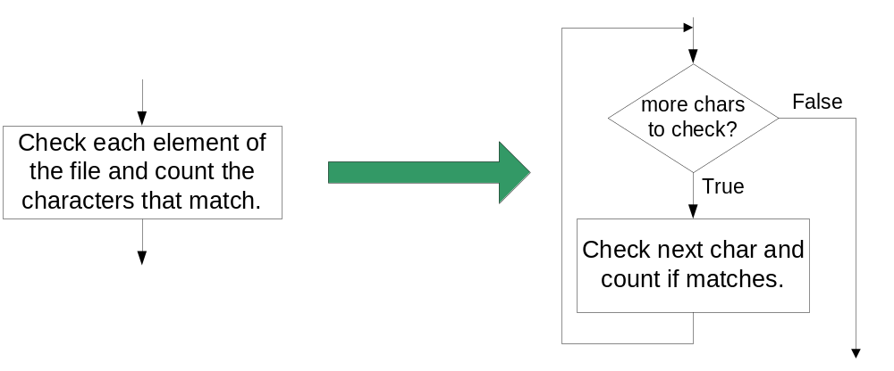
Iterative
Do Subtask over and over,
as long as the test condition is true.
6-<number>

Slide 9
Problem Solving Skills
Learn to convert problem statement
into step-by-step description of subtasks.
  Recognize English words that correlate to three basic constructs:
    “do A then do B” ⇒ sequential
    “if G, then do H” ⇒ conditional
    “for each X, do Y” ⇒ iterative
    “do Z until W” ⇒ iterative
6-<number>

Slide 10
LC-3 Control Instructions
How do we use LC-3 instructions to encode
the three basic constructs?
Sequential
  Instructions naturally flow from one to the next,
  so no special instruction needed to go
  from one sequential subtask to the next.
Conditional and Iterative
  Create code that converts condition into N, Z, or P.
  Example:
  Condition: “Is R0 = R1?”
  Code: Subtract R1 from R0; if equal, Z bit will be set.
  Then use BR instruction to transfer control to the proper subtask.
6-<number>

Slide 11
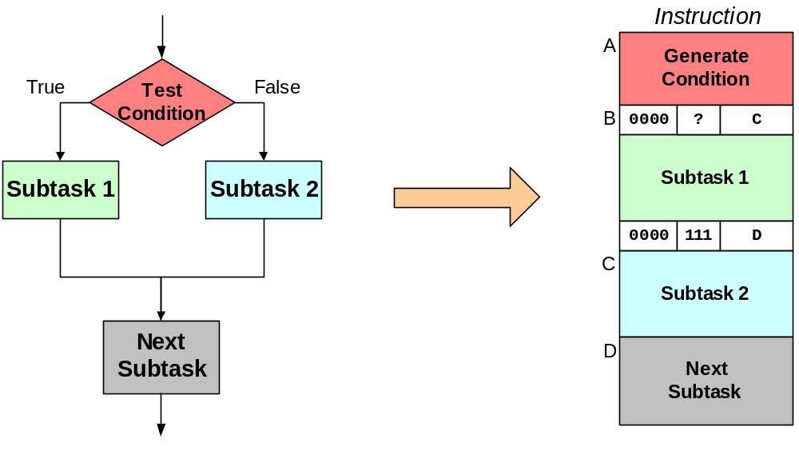
Code for Conditional
PC offset to
address C
Exact bits depend
on condition
being tested
Unconditional branch
to Next Subtask
PC offset to
address D
Assuming all addresses are close enough that PC-relative branch can be used.
6-<number>

Slide 12
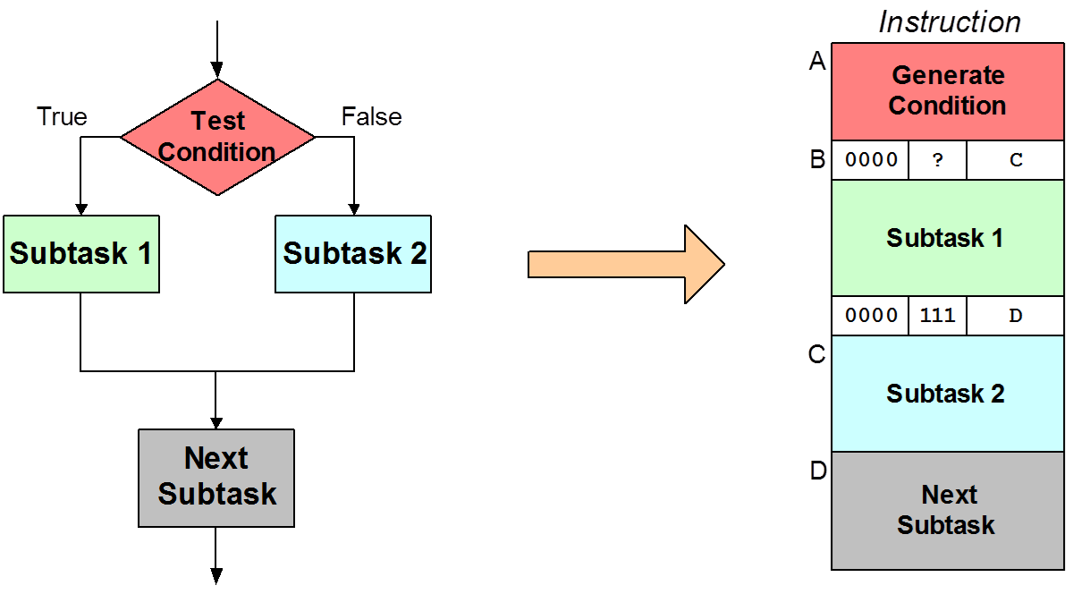
Code for Conditional
PC offset to
address C
Exact bits depend
on condition
being tested
(Test Condition)
Unconditional branch
to Next Subtask
PC offset to
address D
Assuming all addresses are close enough that PC-relative branch can be used.
6-<number>

Slide 13
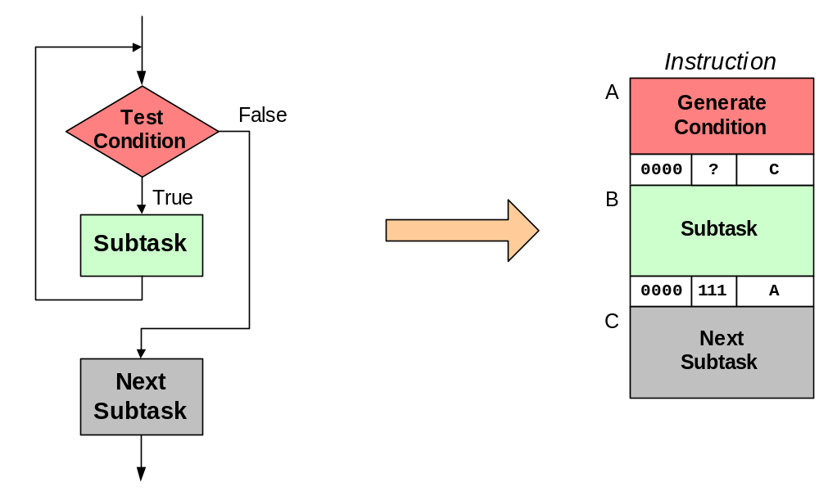
Code for Iteration
Exact bits depend
on condition
being tested
(NOT Test Condition)
PC offset to
address C
Unconditional branch
to retest condition
PC offset to
address A
Assuming all addresses are on the same page.
6-<number>

Slide 14
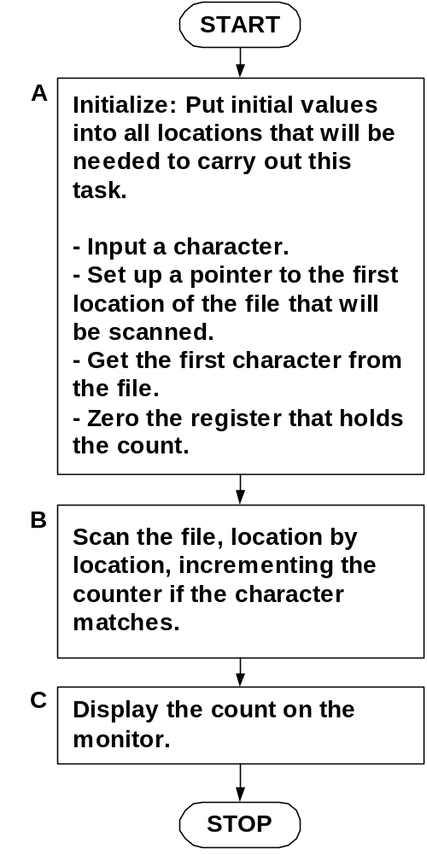
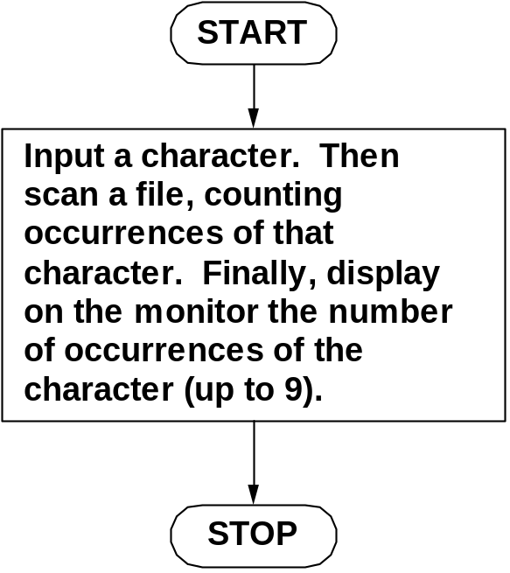
Example: Counting Characters
Initial refinement: Big task into
three sequential subtasks.
6-<number>

Slide 15
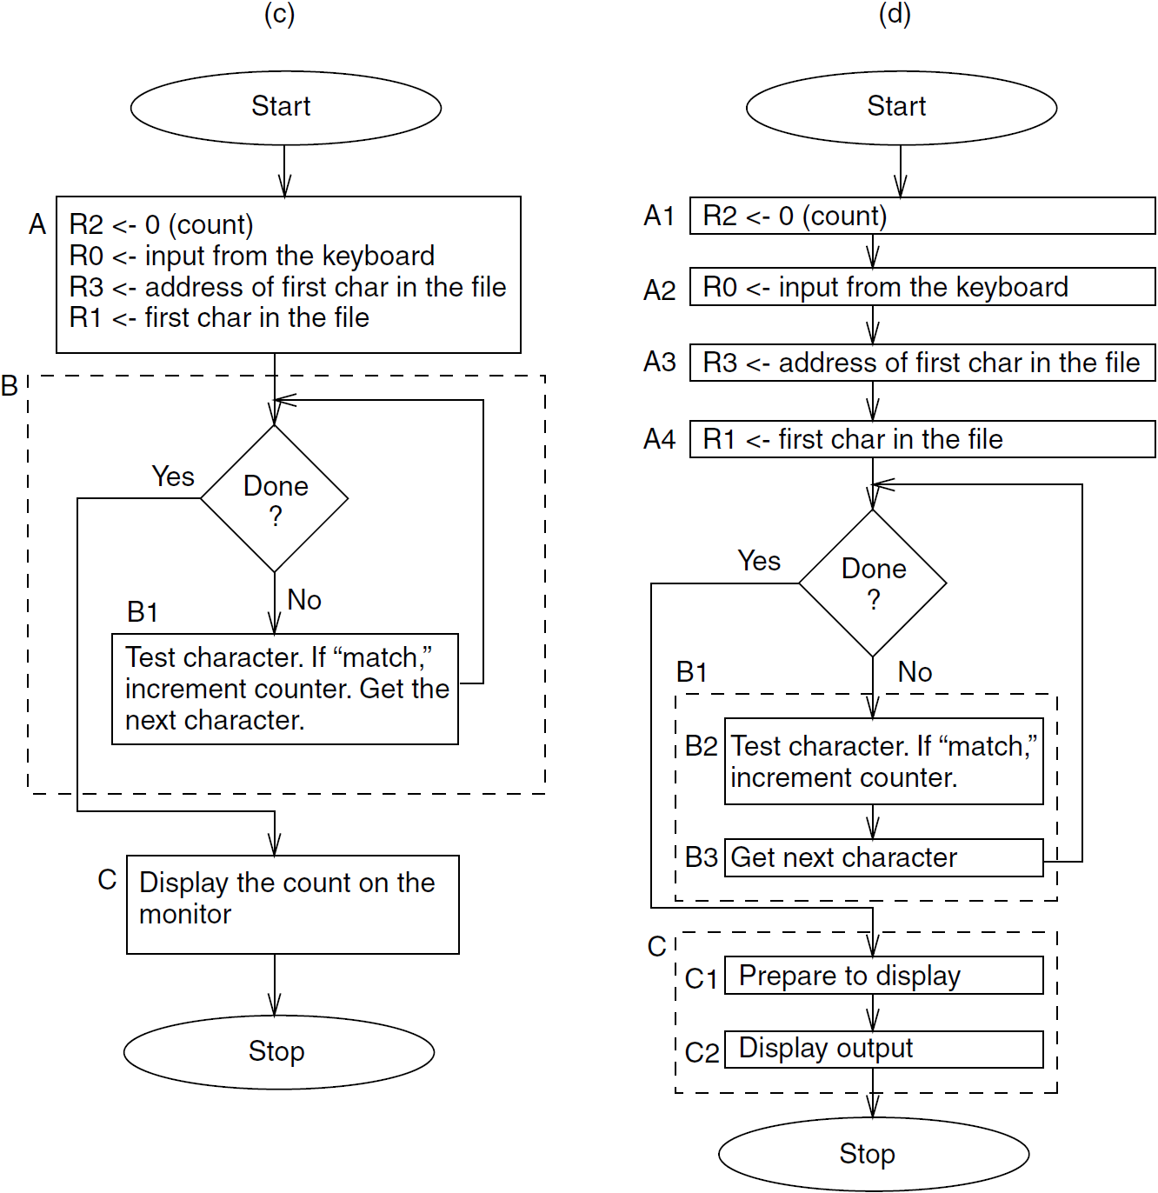
Initial Code in LC-3 Instructions
6-<number>

Slide 16
Stepwise Refinement
6-<number>

Slide 17
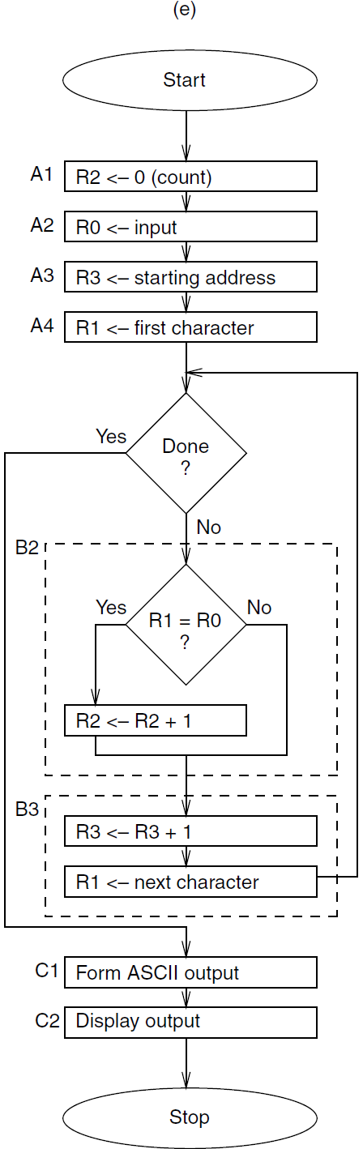
More Stepwise Refinement
6-<number>

Slide 18
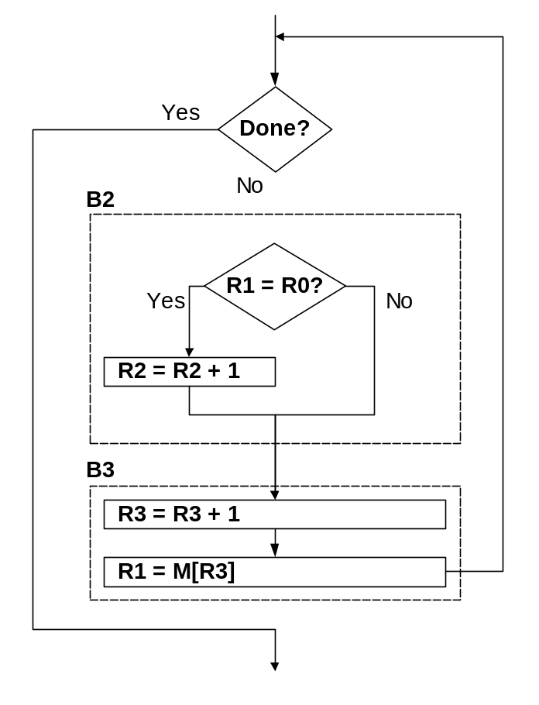
The Last Step: LC-3 Instructions
Use comments to separate into modules and
to document your code.
; Look at each char in file.
0001100001111100 ; is R1 = EOT?
0000010xxxxxxxxx ; if so, exit loop
; Check for match with R0.
1001001001111111 ; R1 = -char
0001001001100001
0001001000000001 ; R1 = R0 – char
0000101xxxxxxxxx ; no match, skip incr
0001010010100001 ; R2 = R2 + 1
; Incr file ptr and get next char
0001011011100001 ; R3 = R3 + 1
0110001011000000 ; R1 = M[R3]
Don’t know
PCoffset bits until
all the code is done
6-<number>

Slide 19
Debugging
You’ve written your program and it doesn’t work.
Now what?
What do you do when you’re lost in a city?
  Drive around randomly and hope you find it?
  Return to a known point and look at a map?
In debugging, the equivalent to looking at a map
is tracing your program.
  Examine the sequence of instructions being executed.
  Keep track of results being produced.
  Compare result from each instruction to the expected result.
6-<number>

Slide 20
Debugging Operations
Any debugging environment should provide means to:
  Display values in memory and registers.
  Deposit values in memory and registers.
  Execute instruction sequence in a program.
  Stop execution when desired.
Different programming levels offer different tools.
  High-level languages (C, Java, ...)
  usually have source-code debugging tools.
  For debugging at the machine instruction level:
    simulators
    operating system “monitor” tools
    in-circuit emulators (ICE)
      plug-in hardware replacements that give
      instruction-level control
6-<number>

Slide 21
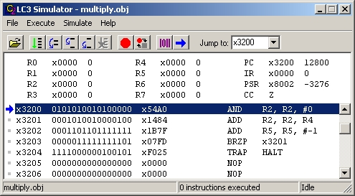
LC-3 Simulator
stop execution,
set breakpoints
execute
instruction
sequences
set/display
registers
and memory
6-<number>

Slide 22
Types of Errors
Syntax Errors
  You made a typing error that resulted in an illegal operation.
  Not usually an issue with machine language,
  because almost any bit pattern corresponds to
  some legal instruction.
  In high-level languages, these are often caught during the
  translation from language to machine code.
Logic Errors
  Your program is legal, but wrong, so
  the results don’t match the problem statement.
  Trace the program to see what’s really happening and
  determine how to get the proper behavior.
Data Errors
  Input data is different than what you expected.
  Test the program with a wide variety of inputs.
6-<number>

Slide 23
Tracing the Program
Execute the program one piece at a time,
examining register and memory to see results at each step.
Single-Stepping
  Execute one instruction at a time.
  Tedious, but useful to help you verify each step of your program.
Breakpoints
  Tell the simulator to stop executing when it reaches
  a specific instruction.
  Check overall results at specific points in the program.
    Lets you quickly execute sequences to get a
    high-level overview of the execution behavior.
    Quickly execute sequences that your believe are correct.
Watchpoints
  Tell the simulator to stop when a register or memory location changes
  or when it equals a specific value.
  Useful when you don’t know where or when a value is changed.
6-<number>

Slide 24
Example 1: Multiply
This program is supposed to multiply the two unsigned
integers in R4 and R5.
clear R2
x3200 0101010010100000 R2 <- 0
x3201 0001010010000100 R2 <- R2 + R4
x3202 0001101101111111 R5 <- R5 – 1
x3203 0000011111111101 BRzp x3201
x3204 1111000000100101 HALT
add R4 to R2
decrement R5
R5 = 0?
No
Set R4 = 10, R5 =3.
Run program.
Result: R2 = 40, not 30.
Yes
HALT
6-<number>

Slide 25
Debugging the Multiply Program
Single-stepping
PC | R2 | R4 | R5
x3200 | -- | 10 | 3
x3201 | 0 | 10 | 3
x3202 | 10 | 10 | 3
x3203 | 10 | 10 | 2
x3201 | 10 | 10 | 2
x3202 | 20 | 10 | 2
x3203 | 20 | 10 | 1
x3201 | 20 | 10 | 1
x3202 | 30 | 10 | 1
x3203 | 30 | 10 | 0
x3201 | 30 | 10 | 0
x3202 | 40 | 10 | 0
x3203 | 40 | 10 | -1
x3204 | 40 | 10 | -1
 | 40 | 10 | -1
Breakpoint at branch (x3203)
PC and registers
at the beginning
of each instruction
PC | R2 | R4 | R5
x3203 | 10 | 10 | 2
x3203 | 20 | 10 | 1
x3203 | 30 | 10 | 0
x3203 | 40 | 10 | -1
 | 40 | 10 | -1
Should stop looping here!
Executing loop one time too many.
Branch instruction at x3203 should
be based on Z bit only, not Z and P.
6-<number>

Slide 26
Example 2: Summing an Array of Numbers
This program is supposed to sum the numbers
stored in 10 locations beginning with x3100,
leaving the result in R1.
R1 = 0
R4 = 10
R2 = x3100
x3000 0101001001100000 R1 <- 0
x3001 0101100100100000 R4 <- 0
x3002 0001100100101010 R4 <- R4 + 10
x3003 0010010011111100 R2 <- M[x3100]
x3004 0110011010000000 R3 <- M[R2]
x3005 0001010010100001 R2 <- R2 + 1
x3006 0001001001000011 R1 <- R1 + R3
x3007 0001100100111111 R4 <- R4 - 1
x3008 0000001111111011 BRp x3004
x3009 1111000000100101 HALT
R1 = R1 + M[R2]
R2 = R2 + 1
R4 = R4 - 1
R4 = 0?
No
Yes
HALT
6-<number>

Slide 27
Debugging the Summing Program
Running the the data below yields R1 = x0024,
but the sum should be x8135. What happened?
Address | Contents
x3100 | x3107
x3101 | x2819
x3102 | x0110
x3103 | x0310
x3104 | x0110
x3105 | x1110
x3106 | x11B1
x3107 | x0019
x3108 | x0007
x3109 | x0004
Start single-stepping program...
PC | R1 | R2 | R4
x3000 | -- | -- | --
x3001 | 0 | -- | --
x3002 | 0 | -- | 0
x3003 | 0 | -- | 10
x3004 | 0 | x3107 | 10
Should be x3100!
Program loads contents of M[x3100], not address.
Change opcode of the instruction at x3003
from 0010 (LD) to 1110 (LEA).
6-<number>

Slide 28
Example 3: Looking for a 5
This program is supposed to set
R0=1 if there’s a 5 in one of the ten
memory locations, starting at x3100.
Else, it should set R0 to 0.
R0 = 1, R1 = -5, R3 = 10
R4 = x3100, R2 = M[R4]
x3000 0101000000100000 R0 <- 0
x3001 0001000000100001 R0 <- R0 + 1
x3002 0101001001100000 R1 <- 0
x3003 0001001001111011 R1 <- R1 - 5
x3004 0101011011100000 R3 <- 0
x3005 0001011011101010 R3 <- R3 + 10
x3006 0010100000001001 R4 <- M[x3010]
x3007 0110010100000000 R2 <- M[R4]
x3008 0001010010000001 R2 <- R2 + R1
x3009 0000010000000101 BRz x300F
x300A 0001100100100001 R4 <- R4 + 1
x300B 0001011011111111 R3 <- R3 - 1
x300C 0110010100000000 R2 <- M[R4]
x300D 0000001111111010 BRp x3008
x300E 0101000000100000 R0 <- 0
x300F 1111000000100101 HALT
x3010 0011000100000000 x3100
R2 = 5?
Yes
No
R3 = 0?
R4 = R4 + 1
R3 = R3-1
R2 = M[R4]
No
Yes
R0 = 0
HALT
6-<number>

Slide 29
Debugging the Fives Program
Running the program with a 5 in location x3108
results in R0 = 0, not R0 = 1. What happened?
Perhaps we didn’t look at all the data?
Put a breakpoint at x300D to see
how many times we branch back.
Address | Contents
x3100 | 9
x3101 | 7
x3102 | 32
x3103 | 0
x3104 | -8
x3105 | 19
x3106 | 6
x3107 | 13
x3108 | 5
x3109 | 61
PC | R0 | R2 | R3 | R4
x300D | 1 | 7 | 9 | x3101
x300D | 1 | 32 | 8 | x3102
x300D | 1 | 0 | 7 | x3103
 | 0 | 0 | 7 | x3103
Didn’t branch
back, even
though R3 > 0?
Branch incorrectly uses condition code set by
loading R2 with M[R4], not by decrementing R3.
Swap x300B and x300C, or remove x300C and
branch back to x3007.
6-<number>

Slide 30
Example 4: Finding First 1 in a Word
This program is supposed to return (in R1) the bit position of the first 1 in a word. The address of the word is in location x3009 (just past the end of the program). If there
are no ones, R1 should be set to –1.
R1 = 15
R2 = data
x3000 0101001001100000 R1 <- 0
x3001 0001001001101111 R1 <- R1 + 15
x3002 1010010000000110 R2 <- M[M[x3009]]
x3003 0000100000000100 BRn x3008
x3004 0001001001111111 R1 <- R1 + 1
x3005 0001010010000010 R2 <- R2 + R2
x3006 0000100000000001 BRn x3008
x3007 0000111111111100 BRnzp x3004
x3008 1111000000100101 HALT
x3009 0011000100000000 x3100
R2[15] = 1?
Yes
No
decrement R1
shift R2 left one bit
R2[15] = 1?
No
Yes
HALT
6-<number>

Slide 31
Debugging the First-One Program
Program works most of the time, but if data is zero,
it never seems to HALT.
Breakpoint at backwards branch (x3007)
PC | R1
x3007 | 14
x3007 | 13
x3007 | 12
x3007 | 11
x3007 | 10
x3007 | 9
x3007 | 8
x3007 | 7
x3007 | 6
x3007 | 5
PC | R1
x3007 | 4
x3007 | 3
x3007 | 2
x3007 | 1
x3007 | 0
x3007 | -1
x3007 | -2
x3007 | -3
x3007 | -4
x3007 | -5
If no ones, then branch to HALT
never occurs!
This is called an “infinite loop.”
Must change algorithm to either
(a) check for special case (R2=0), or
(b) exit loop if R1 < 0.
6-<number>

Slide 32
Debugging: Lessons Learned
Trace program to see what’s going on.
  Breakpoints, single-stepping
When tracing, make sure to notice what’s
really happening, not what you think should happen.
  In summing program, it would be easy to not notice
  that address x3107 was loaded instead of x3100.
Test your program using a variety of input data.
  In Examples 3 and 4, the program works for many data sets.
  Be sure to test extreme cases (all ones, no ones, ...).
6-<number>

Slide 33
꼭 기억해야 할 것
Stepwise Refinements by repetitive/nested/recursive applications of three control structures
  Sequential
  Conditional
  Iterative
Mechanical Translation of the control structures to (LC-3) instructions
Debugging – Art rather than Science or Engineering but there are many useful tools
6-<number>

